Slide 1
Simulation and Analysis of Mechanical Properties for Euplectella sp. Skeleton
Cheng-Yu Yang
Professor：Chia-Ching Chou, Ph.D
Institute of Applied Mechanics
National Taiwan University

Slide 2
Outline
What is Euplectella sp. Skeleton?
Research methods
Simulation
Future work
Reference

Slide 3
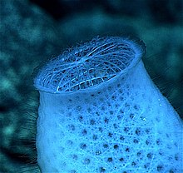
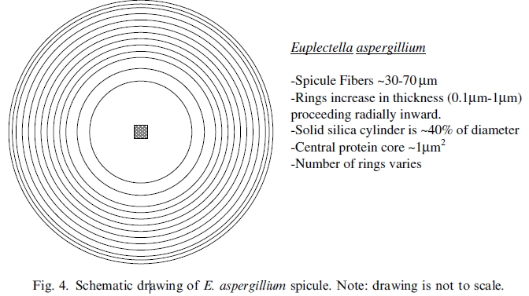
Euplectella sp. Skeleton
Euplectella sp. Skeleton is a marine-sponge-derived biomaterials.
Structure： 6~32cm long , 40~70μm in diameter.
Material: hydrated silica (SiO2˙nH2O) (n=2~5).
Venus flower basket Venus flower basket ,Euplectella sp.,skeketon
Notes:
整頁修正，使聽者更了解你說介紹的構造

Slide 4
Research methods
Coarse-grained modeling
Lattice spring modeling (LSM)
Tool:
MATLAB
Lammps
OVITO

Slide 5
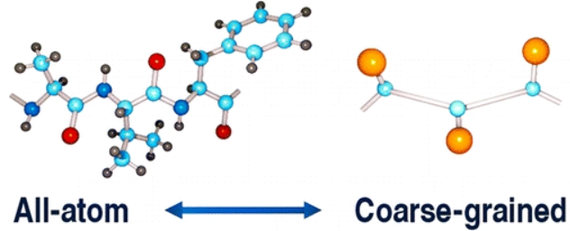
Coarse-grained modeling
Coarse-grained modeling, aim at simulating the behavior of complex systems using their coarse-grained (simplified) representation.

Slide 6
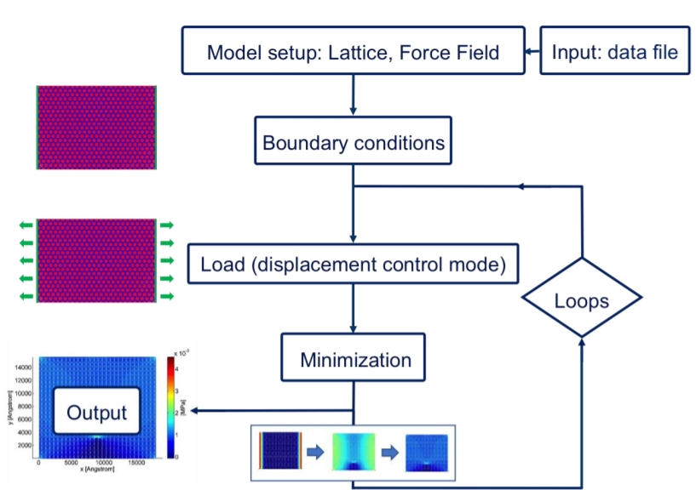
Lattice Spring Modeling (LSM)
Lammps
MATLAB
MATLAB
OVITO

Slide 7
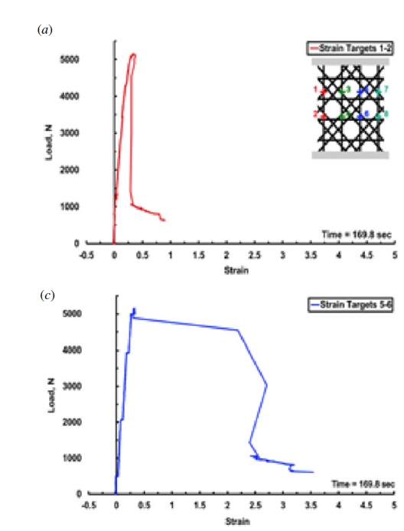
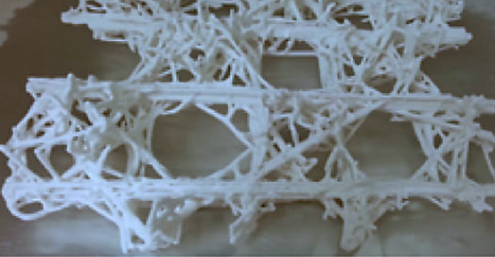
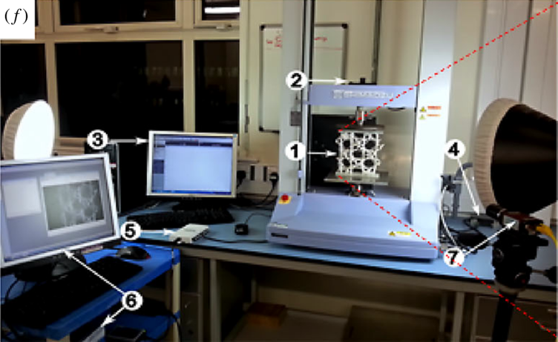
Experimental reference
Strain
Strain
Notes:
坐標軸名字大一點

Slide 8
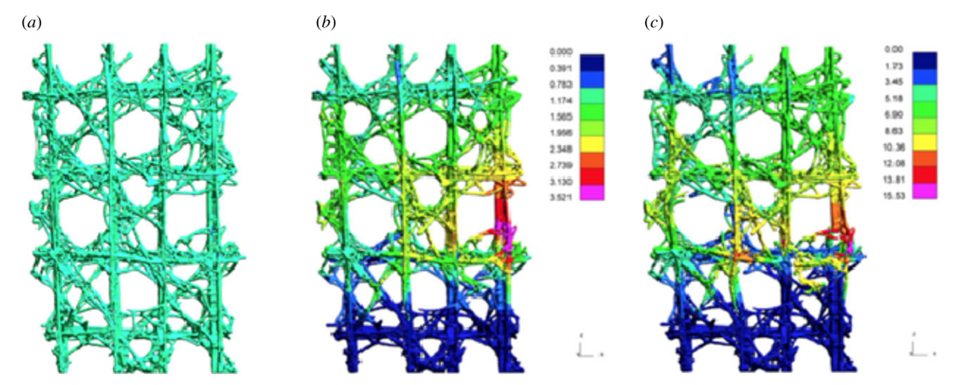
Experimental reference
The team believes that the construction of multi-layer interweaving of nodes improves the ability of local energy absorption.

Slide 9
Simulation
Structure
Structure coefficient
Structure model
Simulation setting
Data

Slide 10
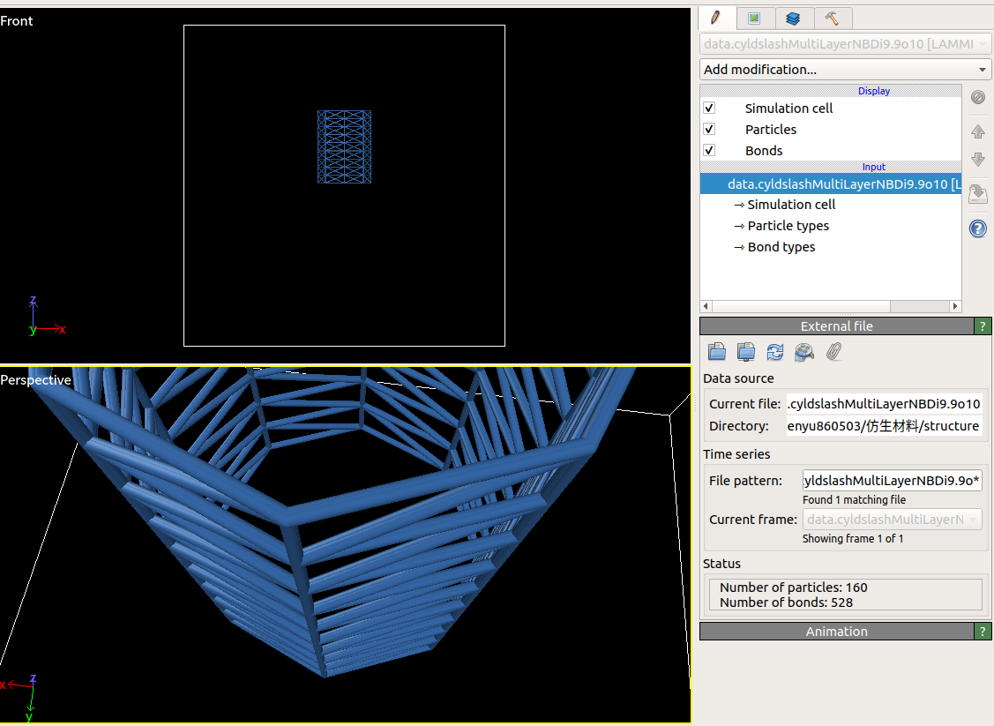
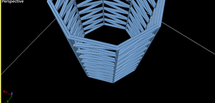
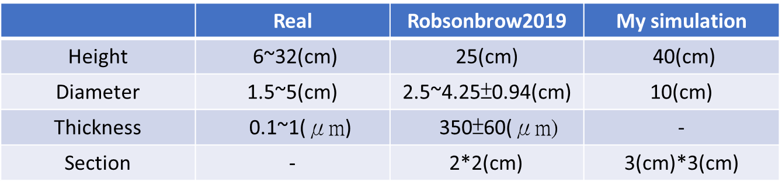
Structure

Slide 11

Simulation setting
Environmental conditions: NPT
Force field:
Bond Potential: Harmonic bond
E = K (r - r0)^2
r0 is the equilibrium bond distance
Intermolecular force: Lennard-Jones potential
σis the finite distance at which the inter-particle potential is zero
εis the depth of the potential well

Slide 12
Future work
Imitate the compression test done by Robinson team, and improve the structure of the next stage.
Build different layer structure and adjust geometric shape ratio. Observe shape ratio and tensile strength relationship.

Slide 13
謝謝聆聽 !
Thanks!

Slide 14
Reference
James C. W.,Joanna A.,Georg E. F., David K.,Alexander W.,Peter A.,Kirk Fields,Michael J.P.,Frank W. Zok,Paul K. H.,Peter Fratzl., Danie.E.M., 2006.Hierarchical assembly of the siliceous skeletal lattice of the hexactinellid sponge Euplectella aspergillum.
Jianhu Shena,Yi Min Xiea,n,Xiaodong H.S.Z,Dong Ruanb., 2012. Mechanical properties of luffa sponge.
Shu-Wei Chang.,Chiu,K.M., 2019.Simulation and Analysis of Mechanical Properties for Bio-inspired Gradient Structurak Materials.
Alexander Epstein,APPHY 226,Spring 2009.Skeleton of Euplectella sp.: Strucural Hierarchy from the Nanoscale to the Macroscale
F. Libonati,V. Cipriano,L. Vergani,M.J. Buehler, computational framework to predict failure and performance of bone-inspired materials, ACS Biomaterials Science & Engineering 3 (12) (2017) 3236-3243.

